Slide 1


UTRGV-EHS-CCP Program
Education Department
Presenters:
Norma Liza Azua UTRGV EHS Senior Director
Dr. Luis Espinoza, UTRGV EHS Data Manager
Ms. Cassandra Martinez, Center Manager PSJA ISD-EHS Buckner Campus
Ms Selina Diaz, Center Manager LEMI 1 & 2

Slide 2

Bus Routes
Introduction to Parents/Families
Teacher Home Visit
Teacher/Parent Conference
School Readiness Goals
ELOF Framework
Milestones and App

Slide 3


Bus Route Schedule

Slide 4

Meet The Teacher/ Welcome to EHS!
EHS teachers contact your parents and welcome your children to Early Head Start! August 26-September 3, 2021
Introduce yourself as the teacher
Ask parent what is the best way of communication for them for future meetings/ conferences, etc.
Write down any important information and always document on your contact log when you have contacted parents.
This is the best opportunity for you to get to know your parents and child.
August 26-
September 3,2020

Slide 5


1st Home Visit
August 26 – September 17
Be sure to schedule a home visit time with parent that is convenient for them.
Be prepared and pre-fill all forms that you will need to fill out:
-Parent Notice
-Home Visit Form
-Home Language Survey
-ASQ3 screener / ASQ SE/ ASQ calculator
-Milestones
-School Readiness Goals (parents)

Slide 6
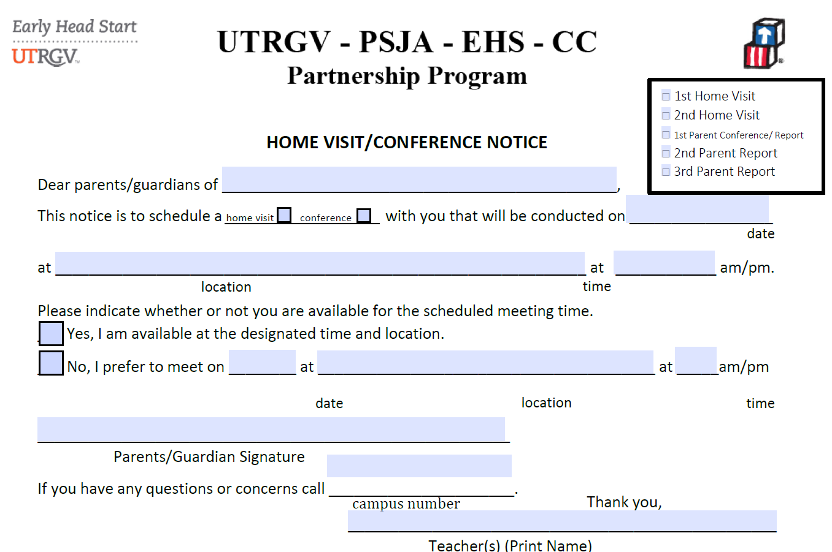

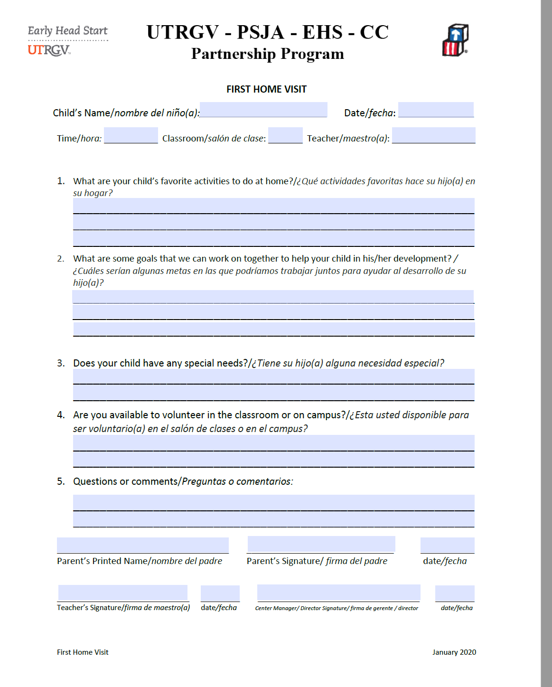

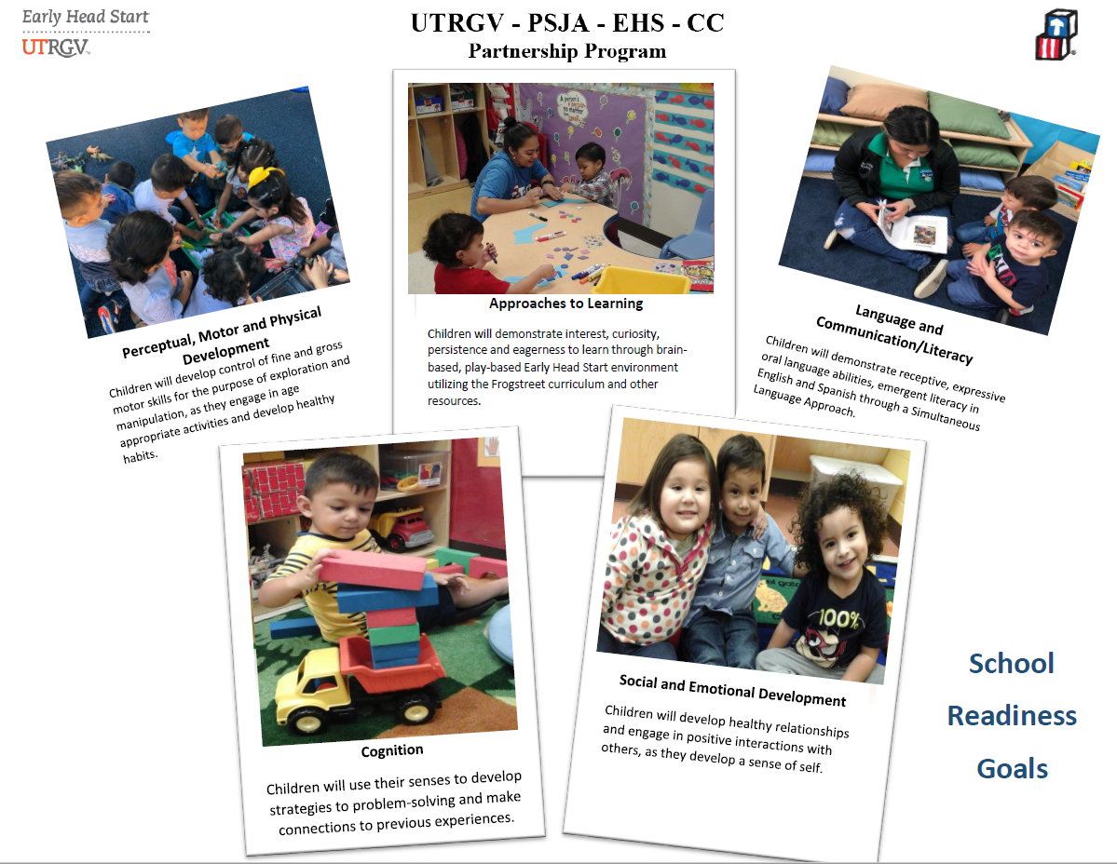

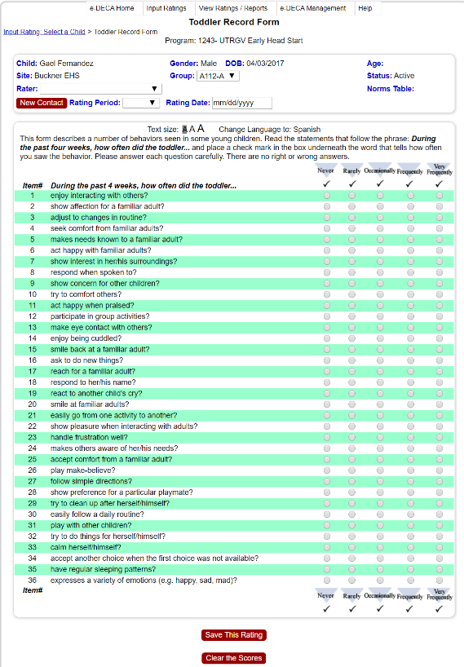



Slide 7
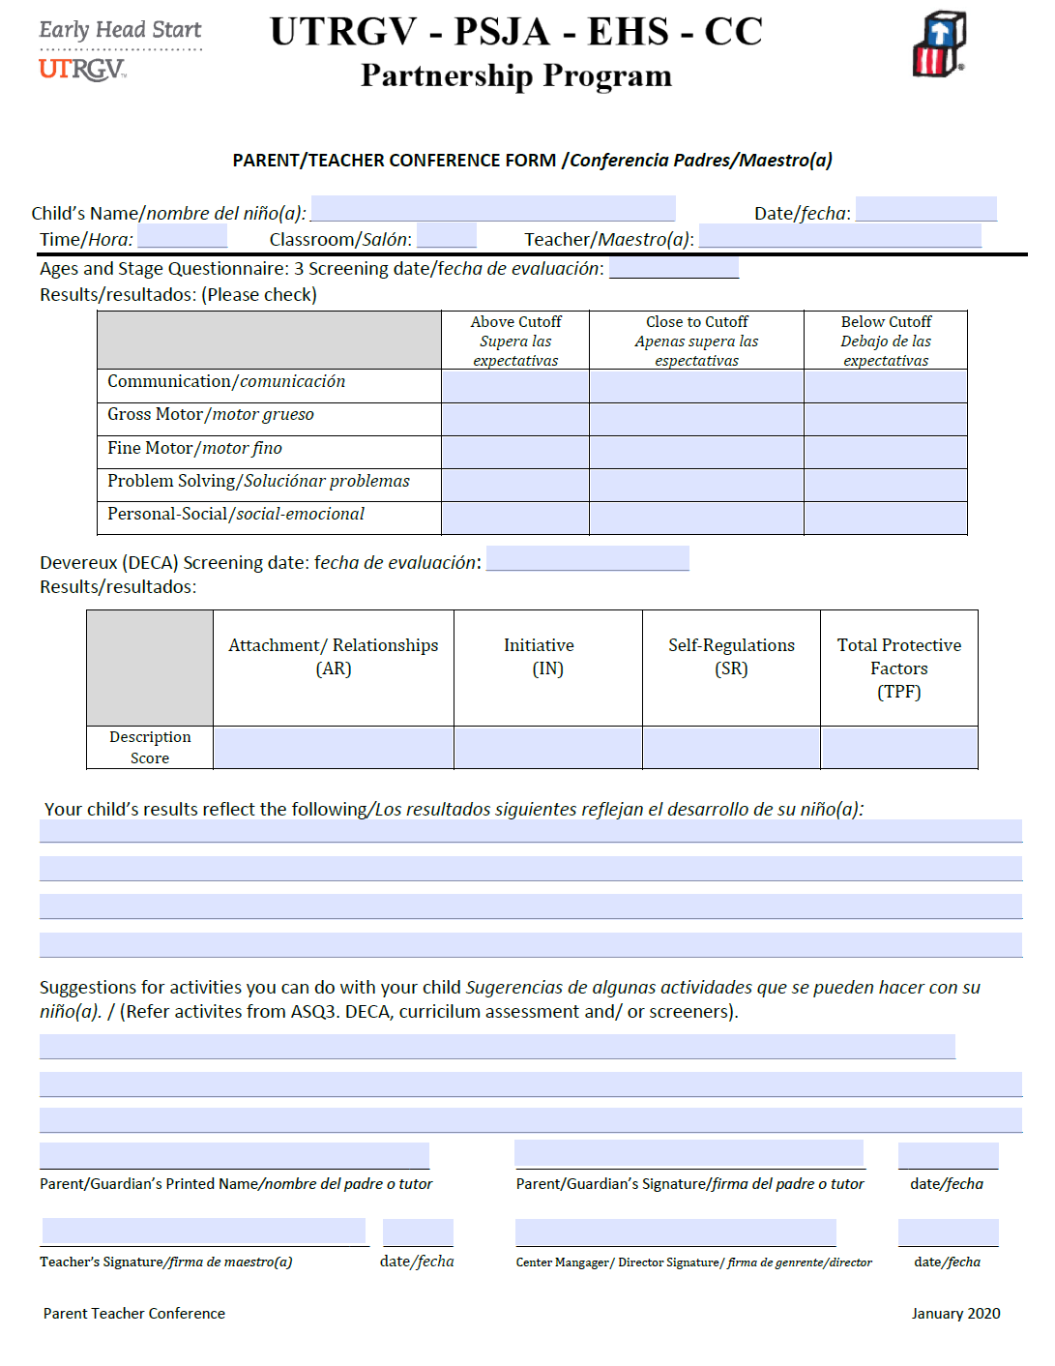
1st Parent Teacher Conference
October 11-October 22
1st Parent Conference IS ONLY based on screeners
Be prepared to share the ASQ3 and ASQ2SE summary and overview with parent.
Share some ASQ3 strategies/ ASQ2SE strategies with parent
Strategies are available on the EHS website under Education / Disabilities
SAVE AND UPLOAD into One Drive labeled as:
1st Parent Teacher Conference

Slide 8


AIMS Parent Teacher Conference
November 8-19
Includes: Parent Notice Form / AIMS Parent Teacher Report
Log Out

Slide 9
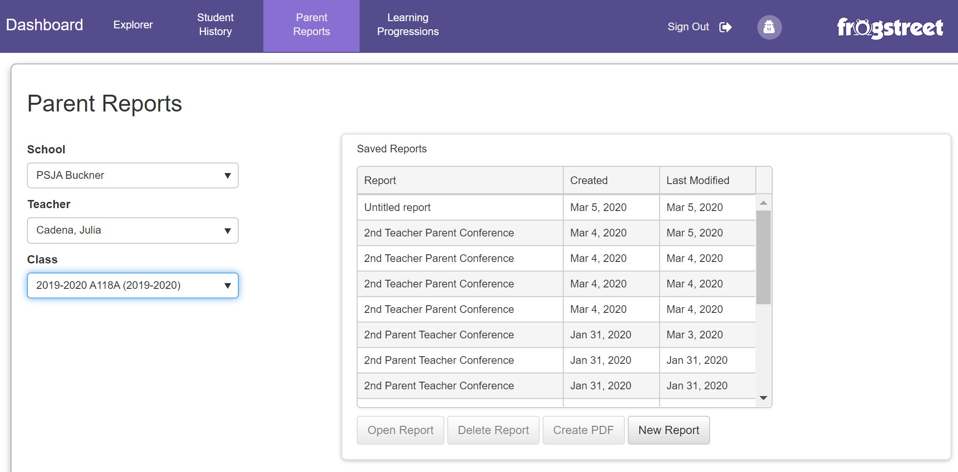

Slide 10
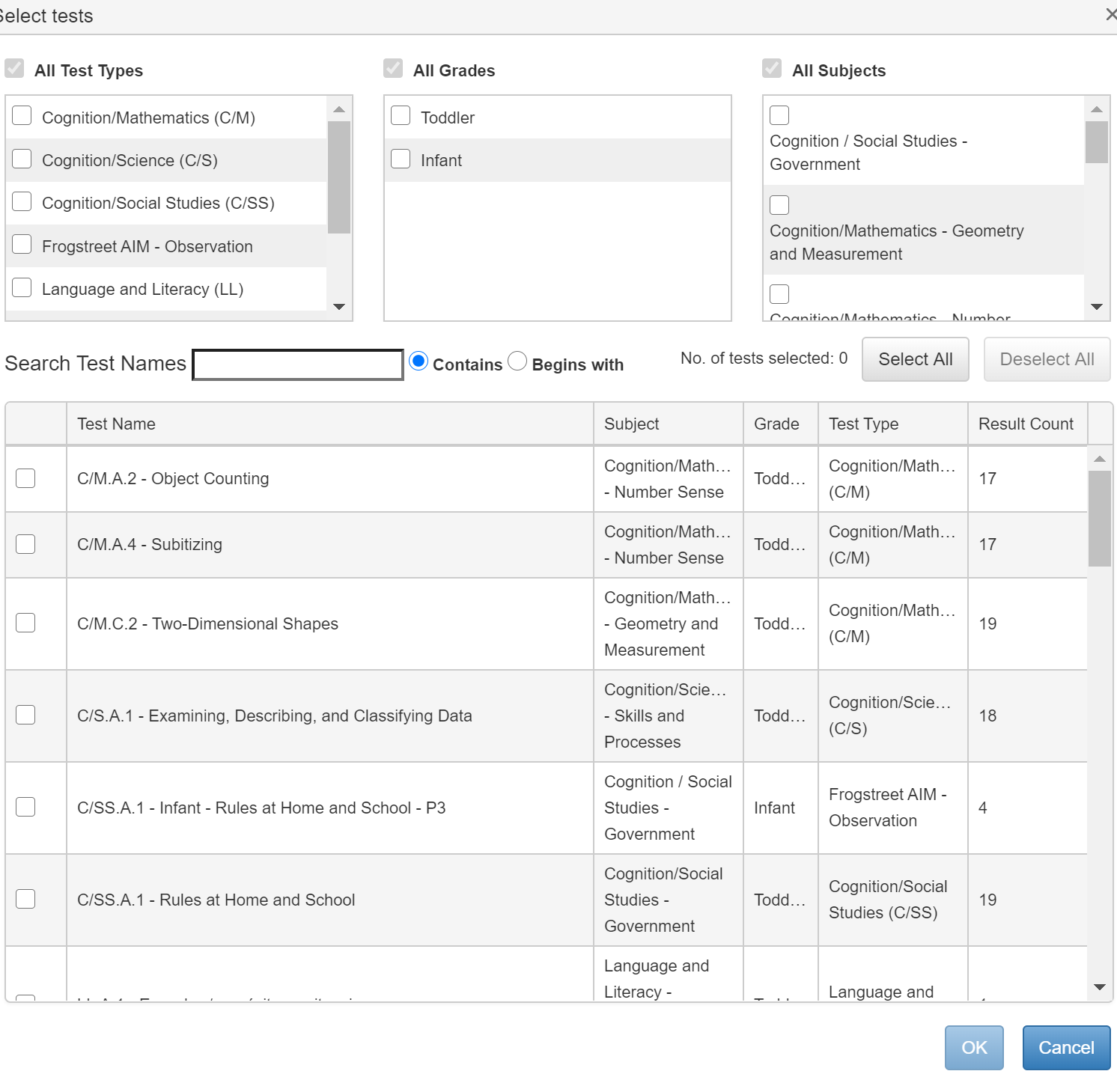
Choose all subjects
Pick a minimum of 2-3 per domain:
-Cognitive
-Social
-Language
-Physical
Then click on “OK”
Pre-Plan and Decide what information you will share with the parent on their scheduled
Home Visit.

Slide 11
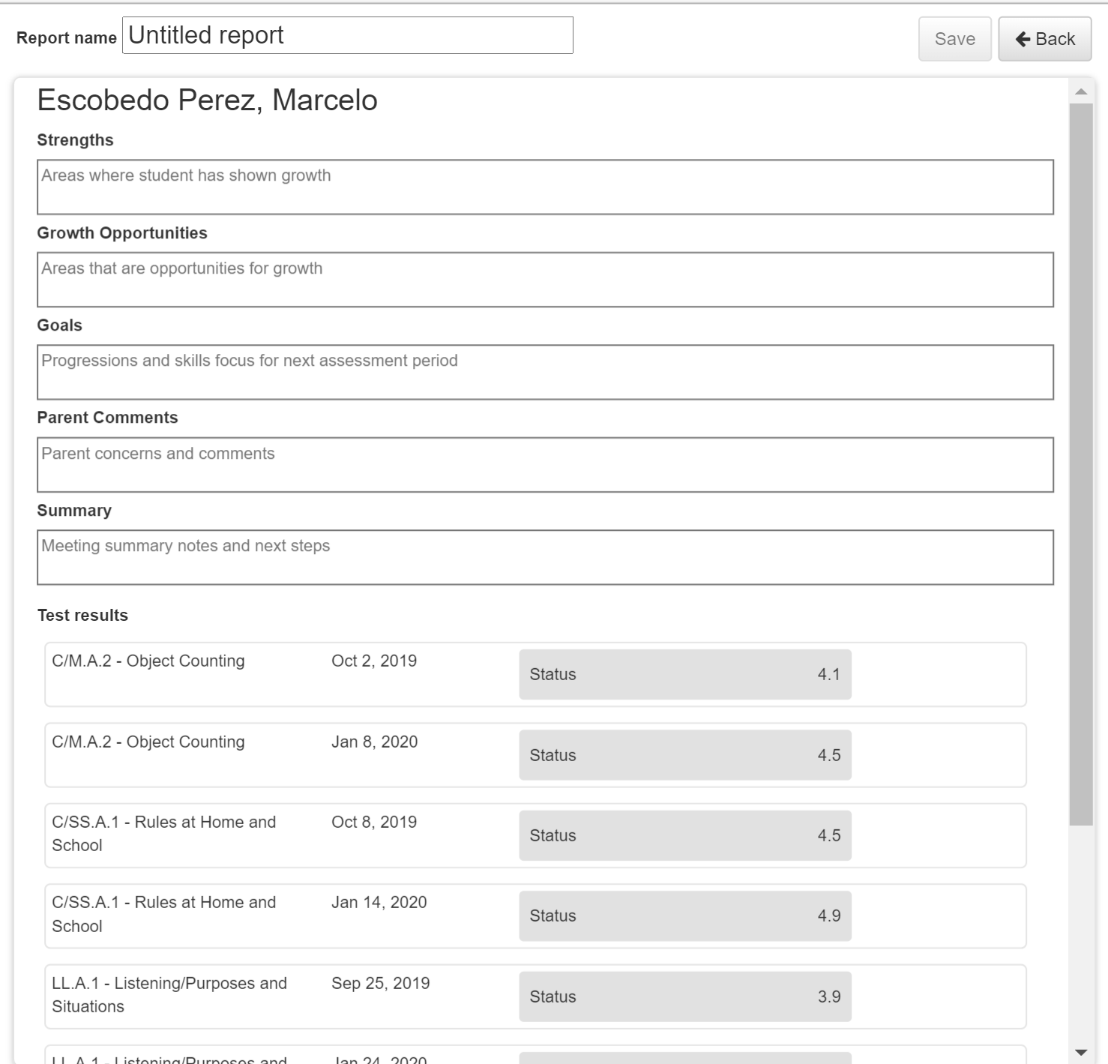
Completing the Parent Report
Label Report:
BOY Parent Conference
Add 1-2 child’s strengths
Add an area of growth opportunities
Add 1-2 goals upon next checkpoint
IF any parent comments add or put “ no comments”
Summary: Next checkpoint is MOY Feb 7-18
Test Results: Choose what you would like to SHARE with the parent. Be Positive and Love your Passengers!

Slide 12
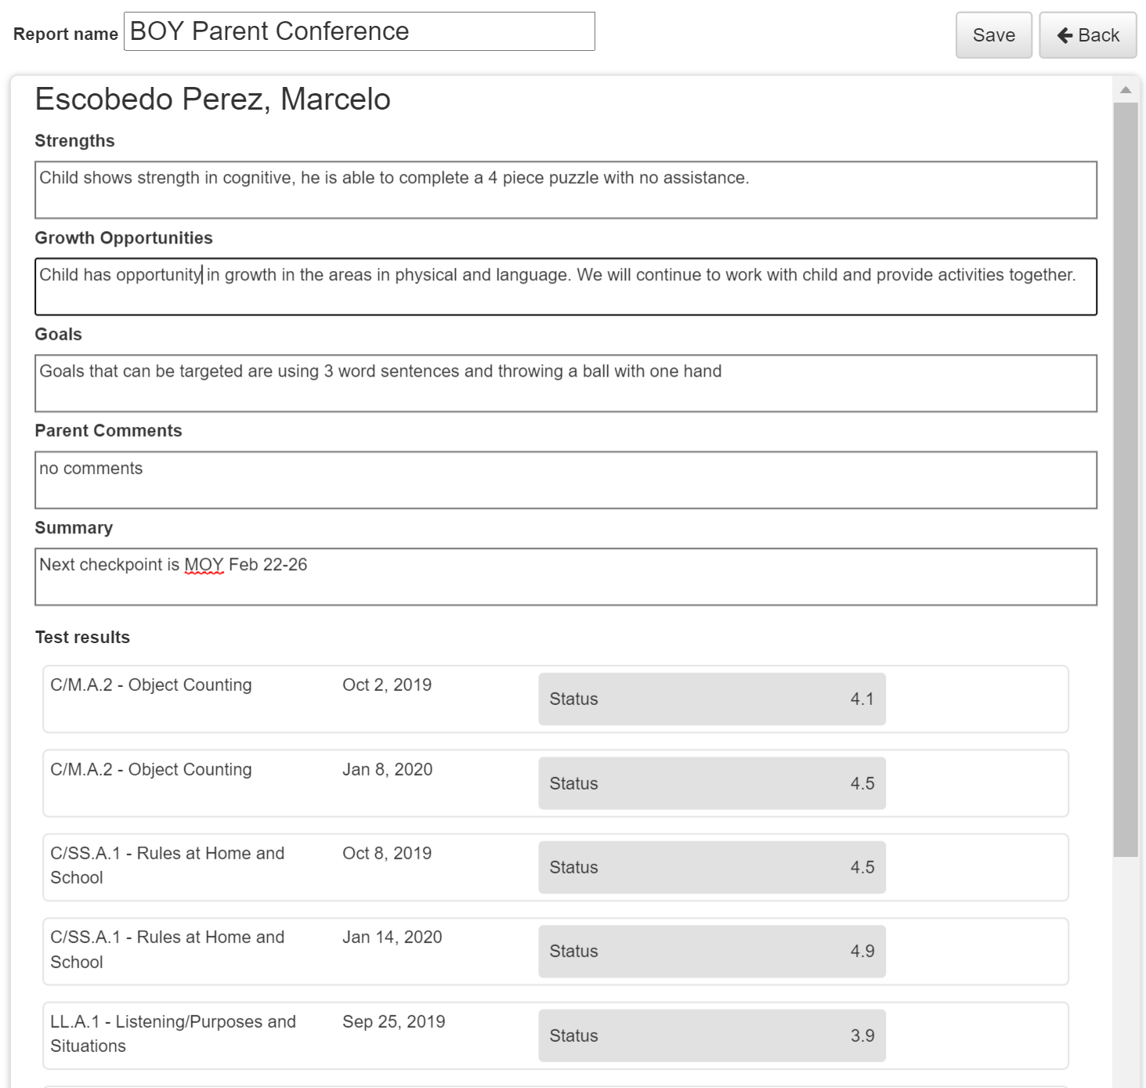


Slide 13


What do I do after my
Parent Conference ?
SAVE and Upload Parent Conference under the
One Drive system on a new folder labeled “Parent Conference (BOY) 2021-2022”.
2) These same steps will be followed for the 2nd (BOY)
& 3rd (MOY) & 4th (EOY) Parent Conference.
Follow the same exact steps.

Slide 14
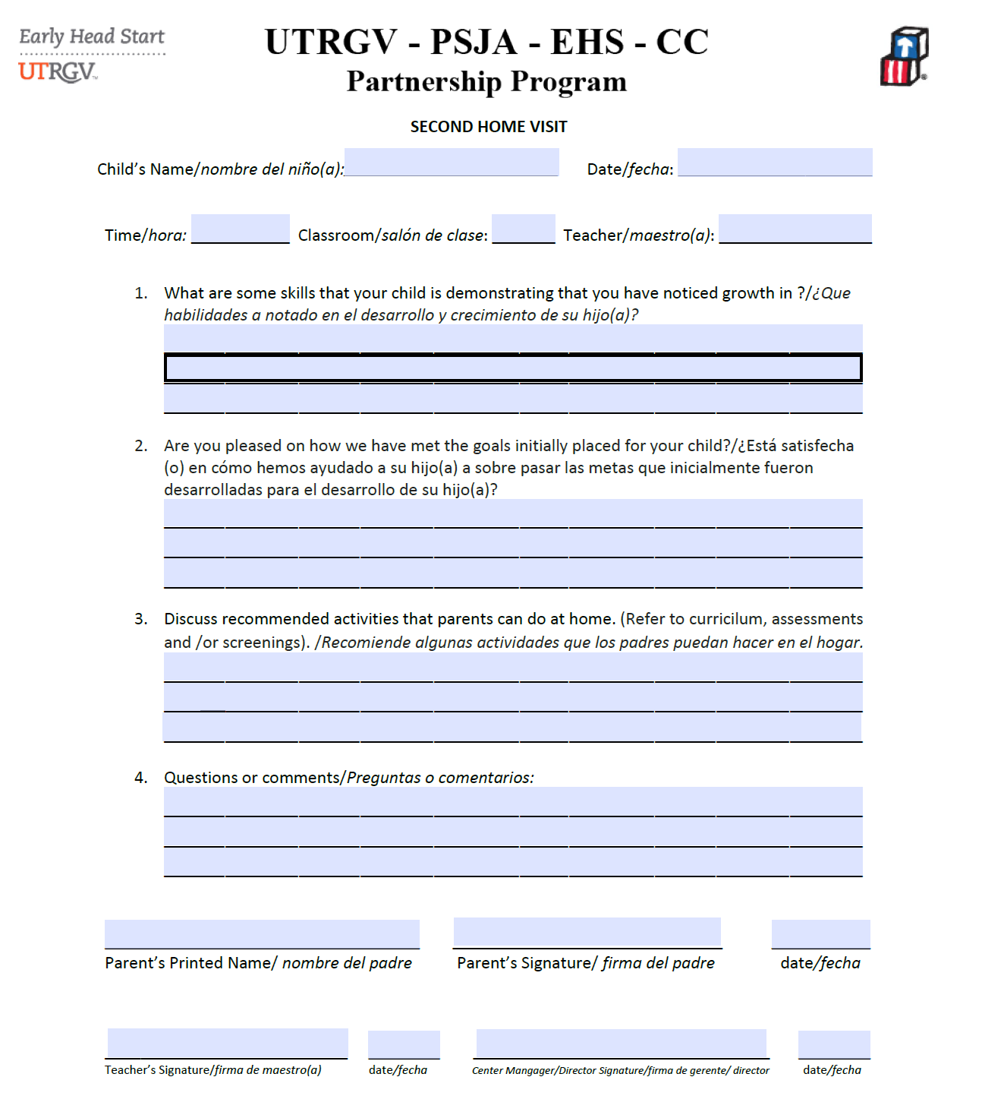
2nd Home Visit
Complete and fill out Parent Notice 2nd Home Visit
Save and upload into One Drive labeled as 2nd Home Visit
Be sure Home Visit is dated the day it is conducted.

Slide 15
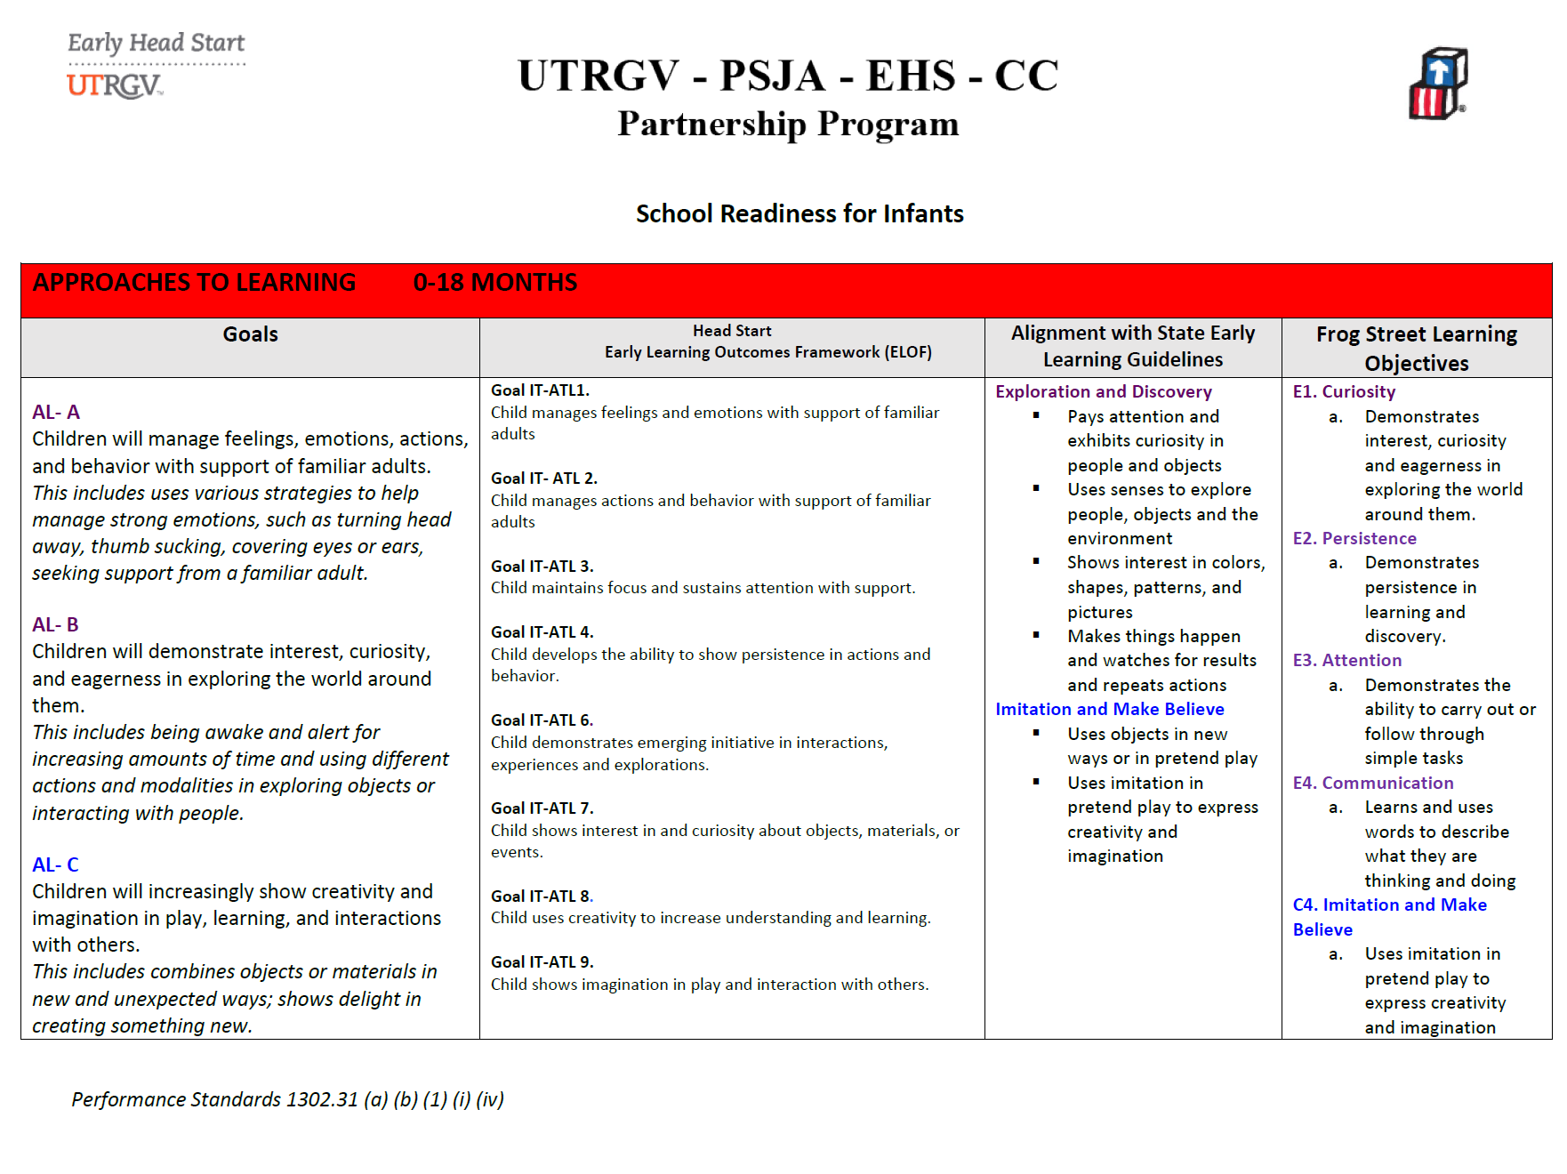


Reminder:
Use all resources you have available to you:
School Readiness Goals
ELOF Framework
ASQ3/ ASQ SE
Milestones of Development

Slide 16
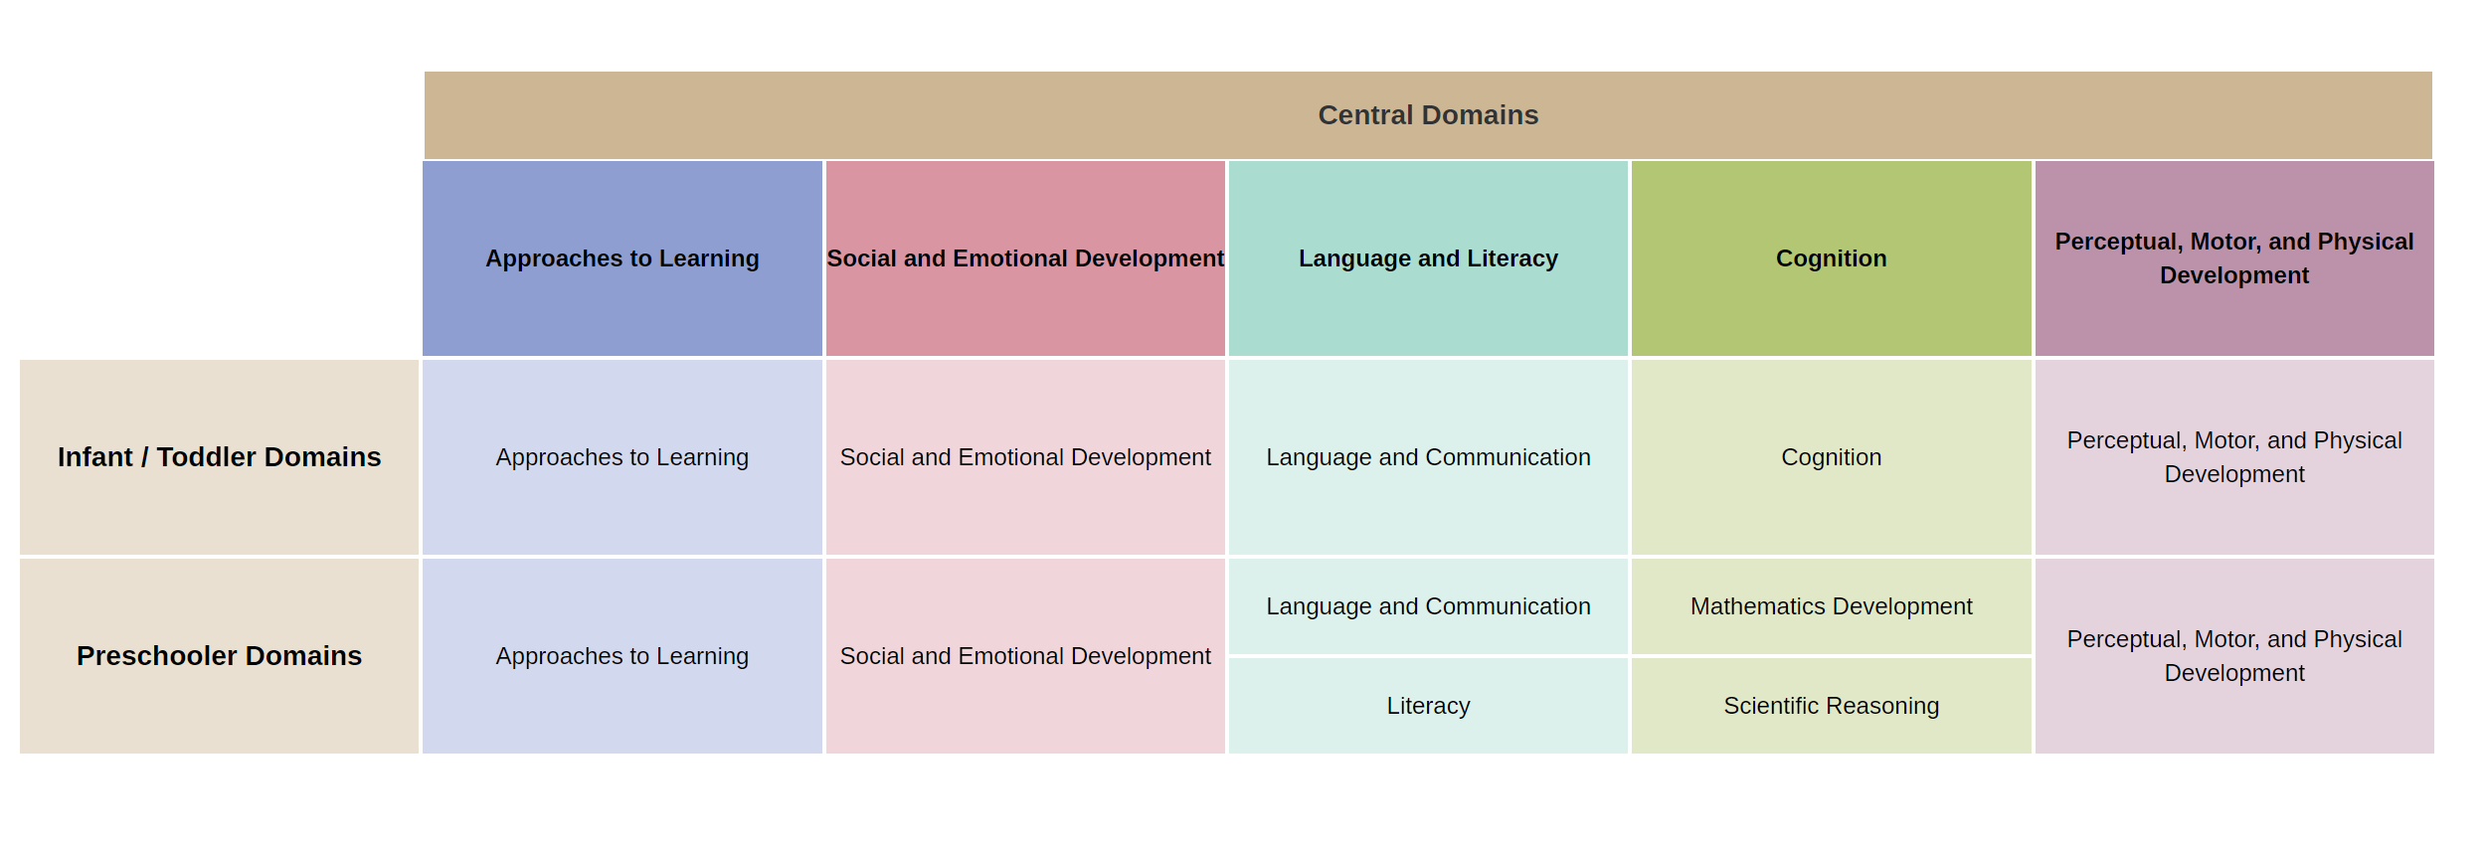
Head Start Early Learning Outcomes Framework Ages:
Birth to Five (ELOF)

Slide 17
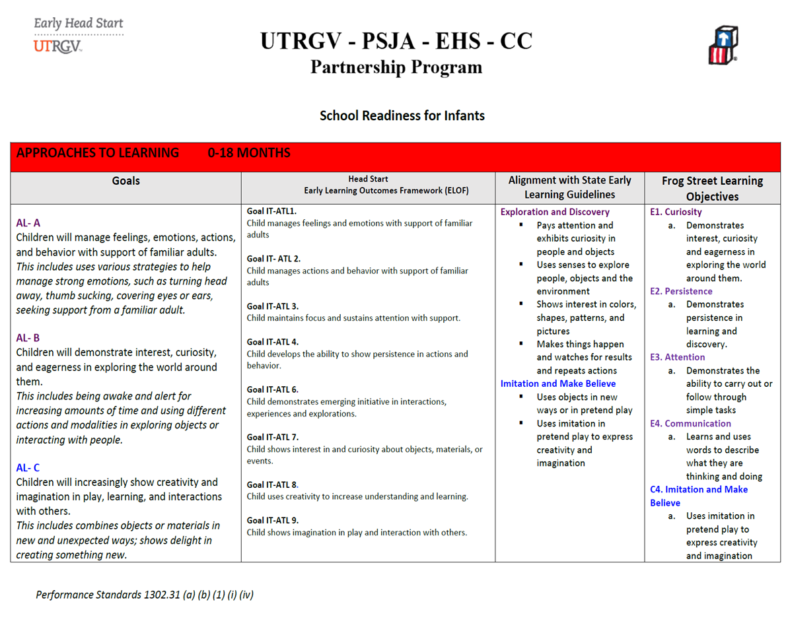

Head Start Curriculum Fidelity
Curriculum fidelity refers to how closely programs apply curriculum content and processes as they are designed.
It is critical that curriculum interactions and activities result in positive child outcomes and achieve school readiness goals.

Slide 18
HSPPS §1302.32(a)(2) Head Start Program Performance Standards say:
”A program must support staff to effectively implement curricula and at a minimum monitor curriculum implementation and fidelity, and provide support, feedback, and supervision for continuous improvement of its implementation through the system of training and professional development.”

Slide 19



